Slide 1
Weak Lensing 3
Tom Kitching

Slide 2
Introduction
Scope of the lecture
Power Spectra of weak lensing
Statistics

Slide 3
Recap
Lensing useful for
  Dark energy
  Dark Matter
Lots of surveys covering 100’s or 1000’s of square degrees coming online now

Slide 4
Recap
Lensing equation
Local mapping
  General Relativity relates this to the gravitational potential
  Distortion matrix implies that distortion is elliptical : shear and convergence
  Simple formalise that relates the shear and convergence (observable) to the underlying gravitational potential

Slide 5
Recap
Observed galaxies have instrinsic ellipticity and shear
Reviewed shape measurement methods
  Moments - KSB
  Model fitting - lensfit
Still an unsolved problem for largest most ambitous surveys
Simulations
  STEP 1, 2
  GREAT08
  Currently LIVE(!) GREAT10

Slide 6
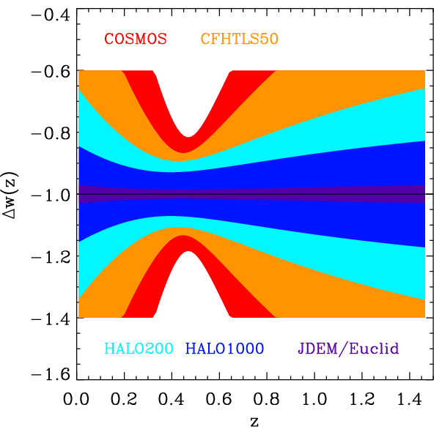
Part V : Cosmic Shear
Introduction to why we use 2-point stats
Spherical Harmonics
Derivation of the cosmic shear power spectra

Slide 7
When averaged over sufficient area the shear field has a mean of zero
Use 2 point correlation function or power spectra which contains cosmological information

Slide 8
Correlation function measures the tendency for galaxies at a chosen separation to have pre- ferred shape alignment

Slide 9
Spherical Harmonics
We want the 3D power spectrum for cosmic shear
  So need to generalise to spherical harmonics for spin-2 field
Normal Fourier Transform

Slide 10
Want equivalent of the CMB power spectrum
CMB is a 2D field
Shear is a 3D field

Slide 11
Spherical Harmonics
Describes general transforms on a sphere for any spin-weight quantity

Slide 12
Spherical Harmonics
For flat sky approximation and a scalar field (s=0)
Covariances of the flat sky coefficients related to the power spectrum

Slide 13
Derivation of CS power spectrum
The shear field we can observe is a 3D spin-2 field
Can write done its spherical harmonic coefficients
  From data :
  From theory :

Slide 14
Derivation of CS power spectrum
How to we theoretically predict γ( r )?
From lecture 2 we know that shear is related to the 2nd derivative of the lensing potential
And that lensing potential is the projected Netwons potential

Slide 15
Derivation of CS power spectrum
Can related the Newtons potential to the matter overdensity via Poisson’s Equation

Slide 16
Derivation of CS power spectrum
Generate theoretical shear estimate:

Slide 17
Simplifies to
Directly relates underlying matter to the observable coefficients

Slide 18
Derivation of CS power spectrum
Now we need to take the covariance of this to generate the power spectrum

Slide 19
Geometry
Large Scale Structure

Slide 20
Tomography
What is “Cosmic Shear Tomography” and how does it relate to the full 3D shear field?
The Limber Approximation
  (k_{x},k_{y},k_{z}) projected to (k_{x},k_{y})

Slide 21
Tomography
Limber ok at small scales
Very useful Limber Approximation formula (LoVerde & Afshordi)

Slide 23
Tomography
Limber Approximation (lossy)
Transform to Real space (benign)
Discretisation in redshift space (lossy)

Slide 24

Tomography
  Generate 2D shear correlation in redshift bins
  Can “auto” correlate in a bin
  Or “cross” correlate between bin pairs
  i and j refer to redshift bin pairs
z

Slide 26
Part VI : Prediction
Fisher Matrices
Matrix Manipulation
Likelihood Searching

Slide 27
What do we want?
How accurately can we estimate a model parameter from a given data set?
Given a set of N data point x₁,…,x_{N}
  Want the estimator to be unbiased
  Give small error bars as possible
The Best Unbiased Estimator
A key Quantity in this is the Fisher (Information) Matrix

Slide 28
What is the (Fisher) Matrix?
Lets expand a likelihood surface about the maximum likelihood point
Can write this as a Gaussian
Where the Hessian (covariance) is

Slide 29
What is the Fisher Matrix?
The Hessian Matrix has some nice properties
Conditional Error on α
Marginal error on α

Slide 30
What is the Fisher Matrix?
The Fisher Matrix defined as the expectation of the Hessian matrix
This allows us to make predictions about the performance of an experiment !
The expected marginal error on α

Slide 31
Cramer-Rao
Why do Fisher matrices work?
The Cramer-Rao Inequality :
  For any unbiased estimator

Slide 32
The Gaussian Case
How do we calculate Fisher Matrices in practice?
Assume that the likelihood is Gaussian

Slide 33
The Gaussian Case
derivative
matrix identity
derivative

Slide 34
How to Calculate a Fisher Matrix
We know the (expected) covariance and mean from theory
Worked example y=mx+c

Slide 35
Adding Extra Parameters
To add parameters to a Fisher Matrix
Simply extend the matrix

Slide 36
Combining Experiments
If two experiments are independent then the combined error is simply
F_{comb}=F₁+F₂
Same for n experiments

Slide 37
Fisher Future Forecasting
We now have a tool with which we can predict the accuracy of future experiments!
Can easily
  Calculate expected parameter errors
  Combine experiments
  Change variables
  Add extra parameters

Slide 38
For shear the mean shear is zero, the information is in the covariance so (Hu, 1999)
This is what is used to make predictions for cosmic shear and dark energy experiments
Simple code available http://www.icosmo.org

Slide 39
Weak Lensing Surveys
Current and on going surveys
Euclid
DES
LSST
KiDS*
Pan-STARRS 1**
CFHTLenS**
05
10
15
20
25
** complete or surveying
* first light

Slide 41
Dark Energy
Expect constraints of 1% from Euclid

Slide 43
things we didn’t cover
Systematics
  Photometric redshifts
  Intrinsic Alignments
Galaxy-galaxy lensing
  Can use to determine galaxy-scale properties and cosmology
Cluster lensing
Strong lensing
Dark Matter mapping
….
….

Slide 44
Conclusion
Lensing is a simple cosmological probe
  Directly related to General Relativity
  Simple linear image distortions
Measurement from data is challenging
  Need lots of galaxies and very sophisticated experiments
Lensing is a powerful probe of dark energy and dark matter

